Slide 1

HOUSE RENTAL ANALYSIS
PROJECT MEMBERS
MANIKRISHNA SANGANABATLA
CWID : 885638767
EMAIL : msanganabatla@csu.fullerton.edu
KRISHNA ABHISHITH PURIHELLA
CWID : 885211615
EMAIL : purihella.abhi@csu.fullerton.edu

Slide 2
CONTENTS
PROBLEM STATEMENT
APPROACH

Slide 3
PROBLEM STATEMENT
The cost of renting a home varies depending on a number of circumstances, and it is a common practice around the world.
It might be difficult to locate a decent rental home that fits the budget as a tenant. In addition, there is a multitude of rental data accessible due to the rise in popularity of online rental platforms, but processing and analyzing it may be difficult.
As a result, the goal of this project is to thoroughly analyze data on home rentals and the variables that have the greatest impact on rental rates.

Slide 4
Approach:
DATA COLLECTION
DATA CLEANING
EMR CLUSTER CREATION USING AWS
INTEGRATION OF EMR CLUSTER
SUBMISSION OF SPARK JOB
VISUALISATION OF REPORTS
OVERVIEW OF DESIGN

Slide 5
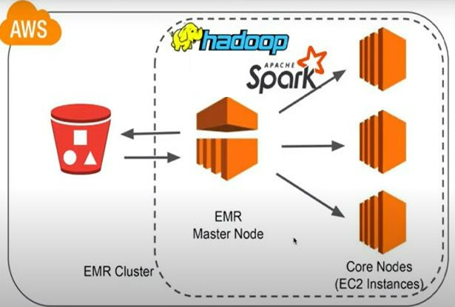
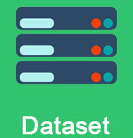


OVERVIEW OF DESIGN:

Slide 6
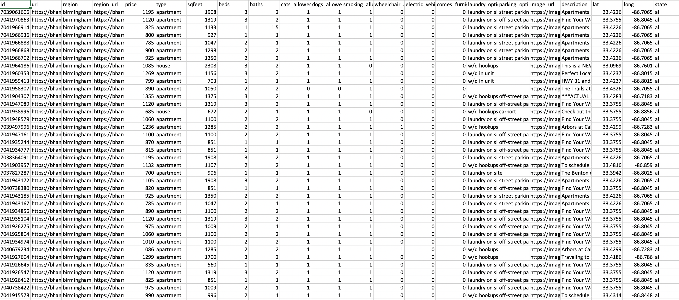
DATA COLLECTION:
A Dataset of around 1.2GB is used in this project. The Dataset is taken from public accessible website Kaggle .
A snap on our Dataset that shows different entities that are involved in our analysis.

Slide 7
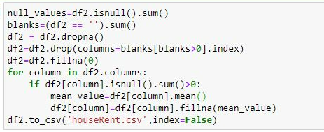
DATA CLEANING (IMPLEMENTATION) :
The DataSet is then subjected to cleaning to remove any NULL or erroneous values that exists. This helps in predicting the house rent with high accuracy

Slide 8
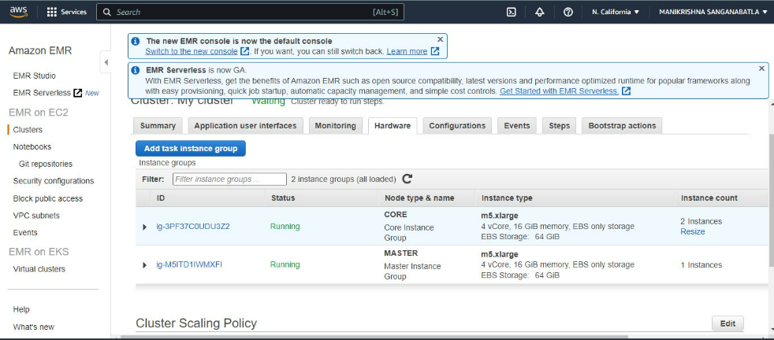
EMR CLUSTER CREATION USING AWS

Slide 9
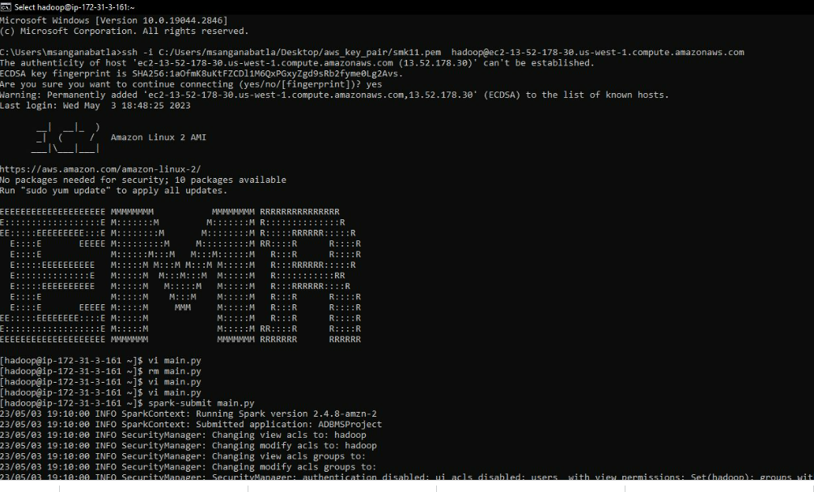
INTEGRATION OF EMR CLUSTER (DEMO)
The Master Node is then integrated with SSH. Which helps AWS communicate with the local. Below is the result of the integration.

Slide 10
SUBMISSION OF SPARK JOB
PySpark queries are executed to give the analysed values . A python file that contains the queries(using PySpark library) are executed over the command (spark-submit <FileName.py>)- thus by submitting a spark job. The Data stored in S3 Bucket is retrieved during the execution of this job.
The following slides demonstrates our PySpark queries and some of the their outputs……..
….to be continued

Slide 11
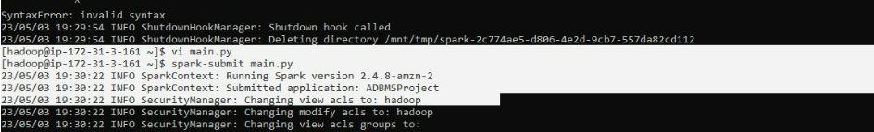
COMMAND LINE EXECUTIONS:

Slide 12
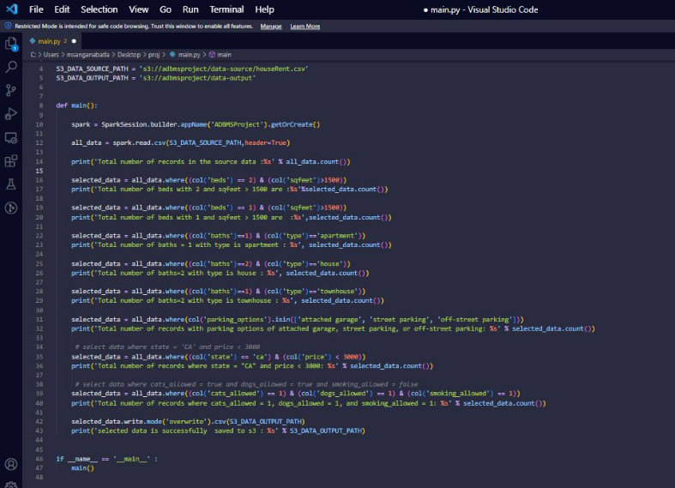
Python File:

Slide 13
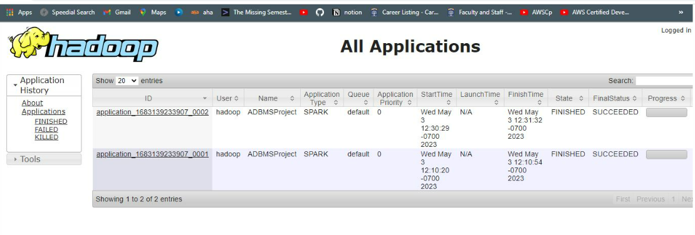
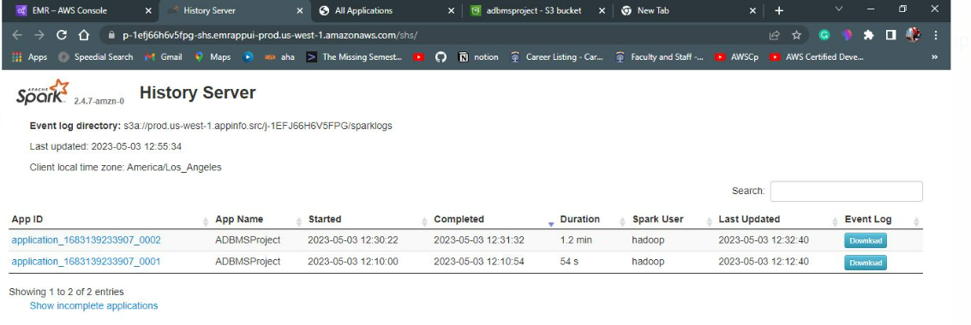

Slide 14
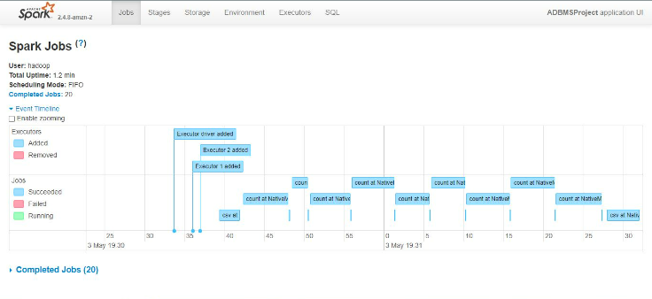
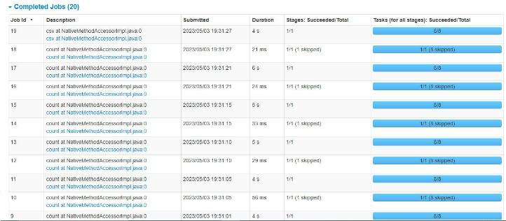

Slide 15
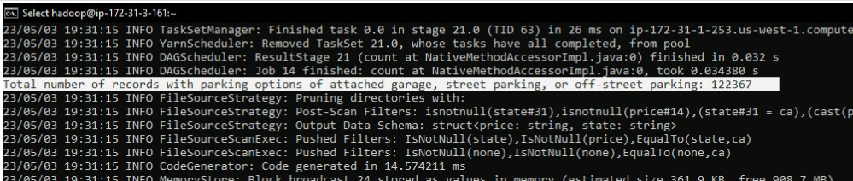
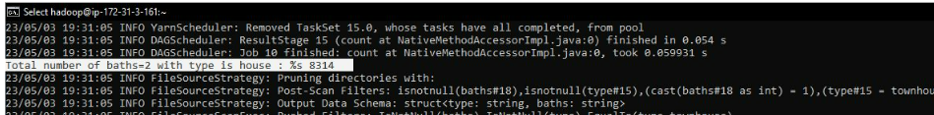
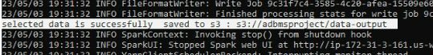
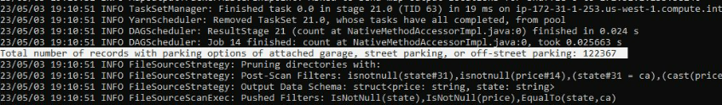

Slide 16
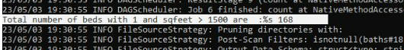
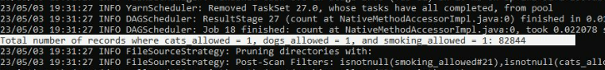
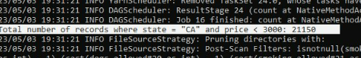
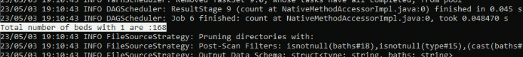
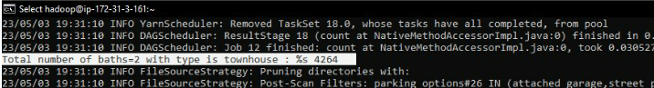
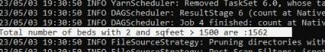

Slide 17
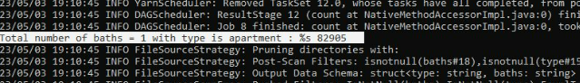
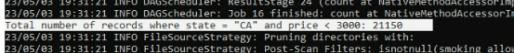
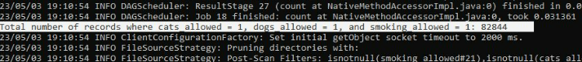
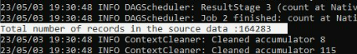
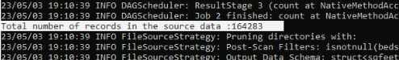
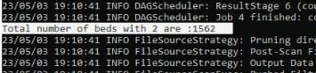

Slide 18
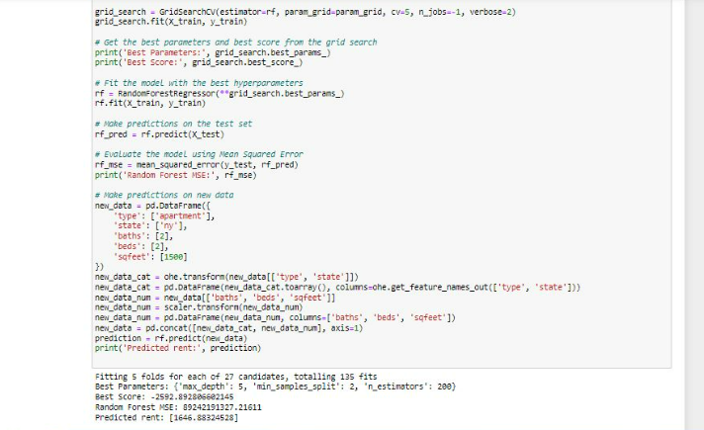
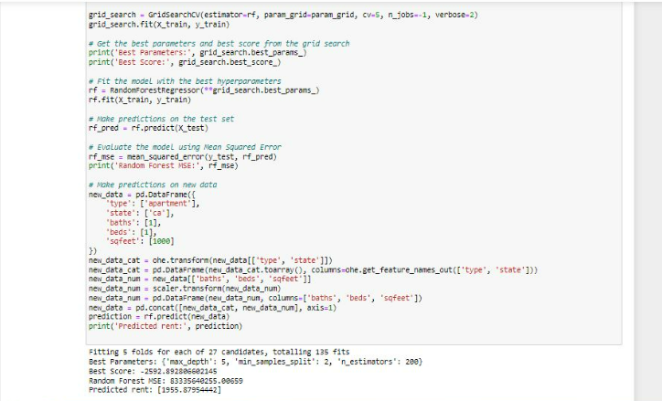




Some of our Machine Learning Algorithms for prediction of rent.

Slide 19
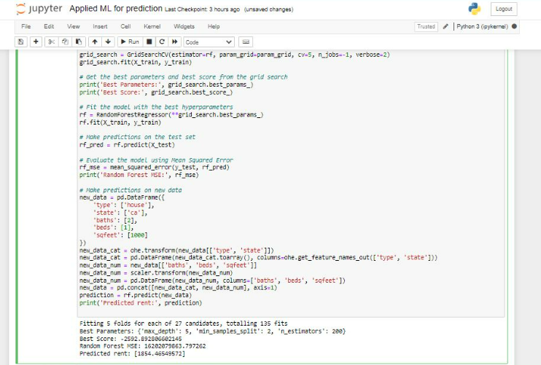
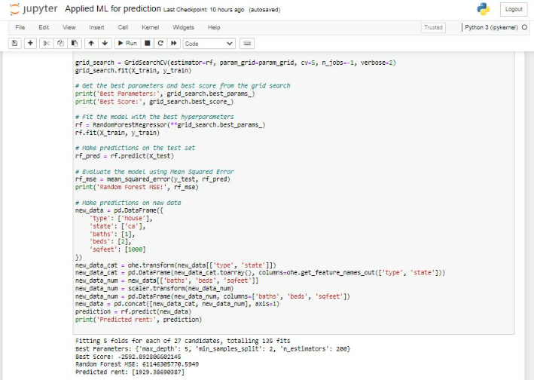





Slide 20
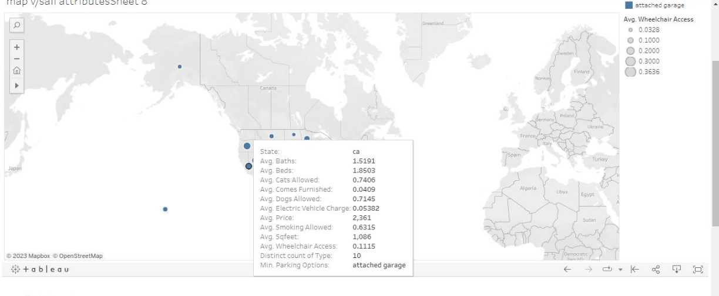


VISUALISATION OF REPORTS:

Slide 21
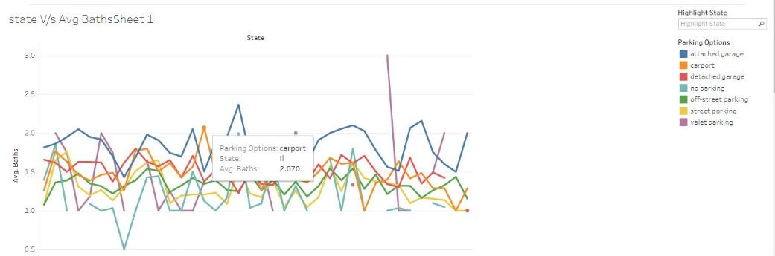
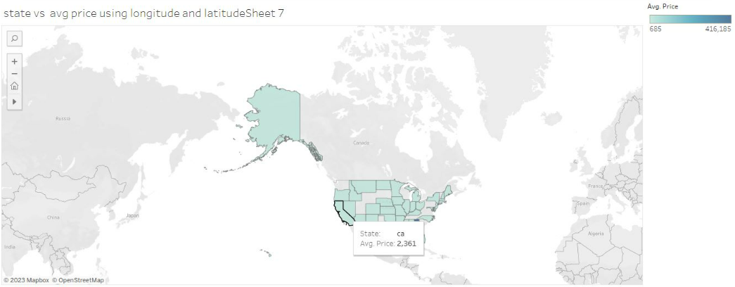

Slide 22
Thankyou

